Slide 1



WebSankalp Technologies
Pune | Sambhajinagar | nashik | mumbai

Slide 2


About WebSankalp
Established in 2018 | A Pune Based Tech Company
We Believe in Digitizing the Process to Enhance Productivity
OUR TEAM
Sales - 02
Operations - 01
Technical – 02
Accounts - 01
OUR USP
End to End Solutions
Pre-Sales Support
In-Time Deliveries
Quality Products
Post Sales Support
Barcode & RFID (AIDC) | Label & Ribbon Rolls | Point of Sales (POS) | Industrial Touch PC (IPC) | Panel PC | Kiosks | Industrial IOT | Software
CCTV Surveillance | Access Control | Video Conferencing | Interactive LED Boards | Display Signages | Li-Ion & LFP Battery Packs
i n f o @ w e b s a n k a l p . c o m | 9 3 2 6 8 2 5 8 9 5 | w w w . w e b s a n k a l p . c o m
P u n e | S a m b h a j I n a g a r | N a s h I k | M u m b a i

Slide 3


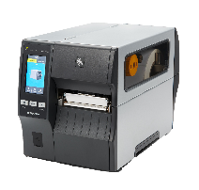
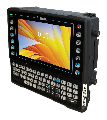

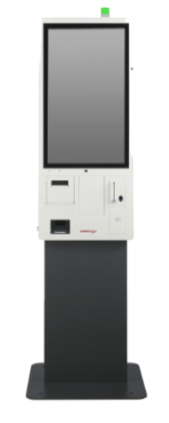
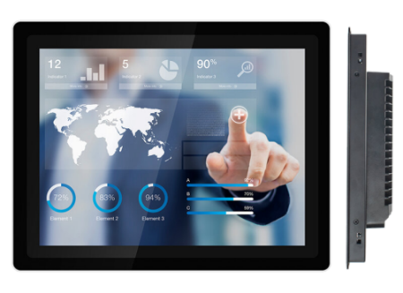
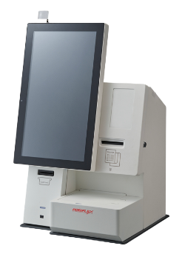

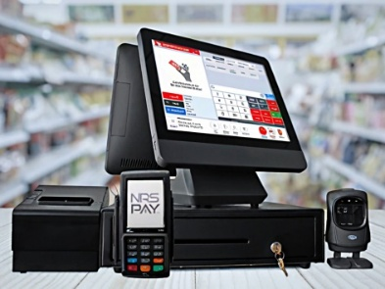




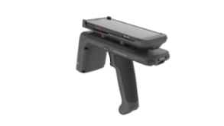



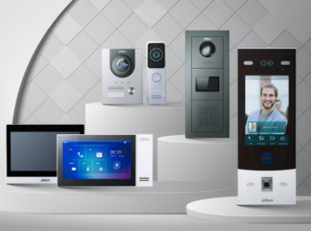


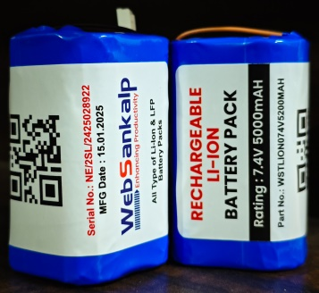

P R O D U C T S & S O L U T I O N S
lE
Barcode & RFID (AIDC)
Hardware, Labels, Ribbons, Services
Point of Sales (POS)
One Stop POS Solution
Industrial Touch PC (IPC)
Panel PC & Box PC
Self Service Kiosks
15 - 32” | Desktop & Wall Mount
Industrial IOT
Custom IIOT Solutions
Software
Custom Applications
CCTV Surveillance
General Purpose & Project Series
Access Control
Fire Alarm & Video Door Phones
Video Conferencing
End to End Meeting Room Setups
Interactive LED Screens
For Institutions & Corporates
Digital Display Signages
Indoor & Outdoor Applications
Battery Packs
Li-Ion & LFP Battery Packs
Barcode & RFID (AIDC) | Label & Ribbon Rolls | Point of Sales (POS) | Industrial Touch PC (IPC) | Panel PC | Kiosks | Industrial IOT | Software
CCTV Surveillance | Access Control | Video Conferencing | Interactive LED Boards | Display Signages | Li-Ion & LFP Battery Packs
i n f o @ w e b s a n k a l p . c o m | 9 3 2 6 8 2 5 8 9 5 | w w w . w e b s a n k a l p . c o m
P u n e | S a m b h a j I n a g a r | N a s h I k | M u m b a i

Slide 4
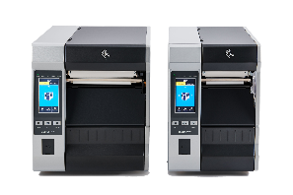
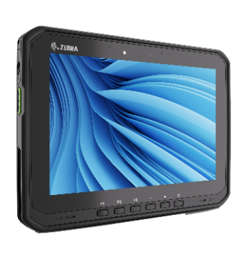
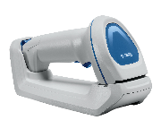

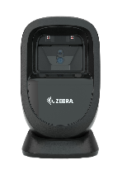

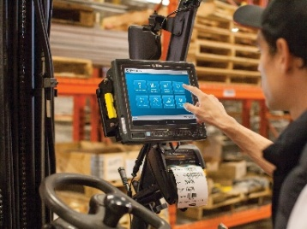

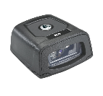


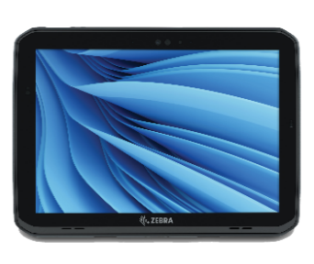

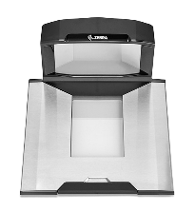
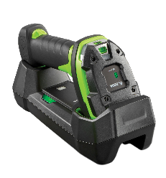
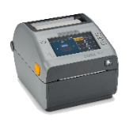
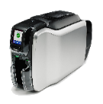
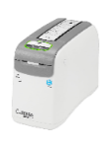
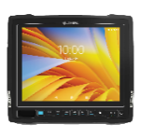

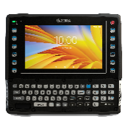
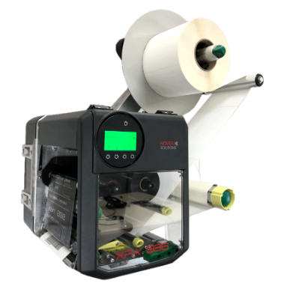

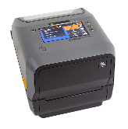
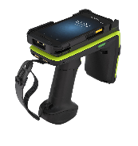
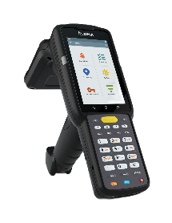
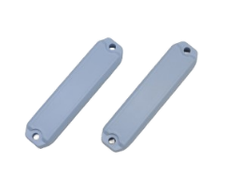
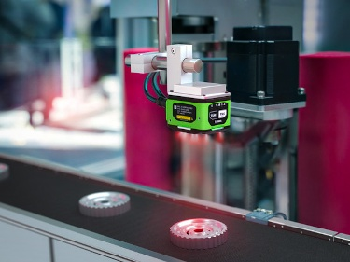

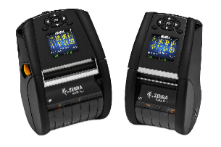
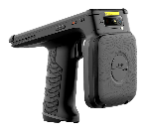

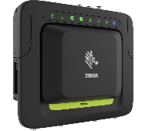

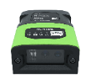
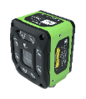















B A R C O D E & R F I D ( A I D C )
lE
Manufacturing Solutions
Barcode Printer
ID, Desktop, Mid Range & Industrial
Barcode Scanners
General, Light Industrial & Industrial
Mobile Computers
Light Industrial & Industrial Rugged
VMT
Android & Windows OS
Industrial Tablets
Android & Windows OS
Healthcare Solutions
Transportation & Logistics
Mobile Printers
2, 3 & 4 Inch
Label Applicators
LPA and Print & Apply Systems
Label & Ribbon Rolls
Plain & Pre-Printed, RFID Tags
RFID Devices
RFID Readers & Printers
Machine Vision
Mission Critical Identifications
Retail Solutions
i n f o @ w e b s a n k a l p . c o m | 9 3 2 6 8 2 5 8 9 5 | w w w . w e b s a n k a l p . c o m
P u n e | S a m b h a j I n a g a r | N a s h I k | M u m b a i

Slide 5
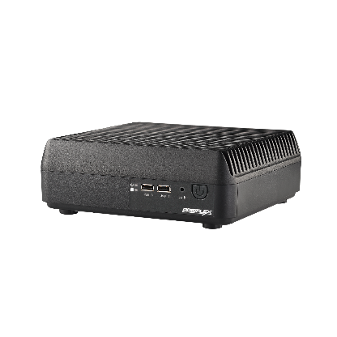

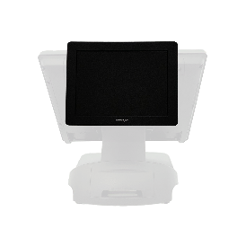
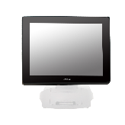
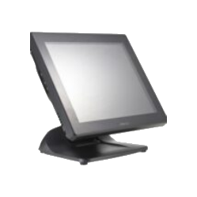
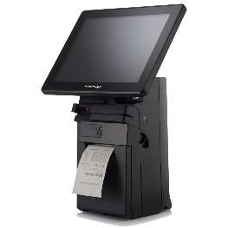
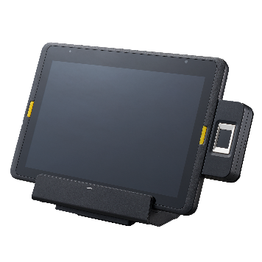
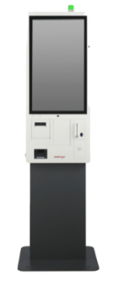
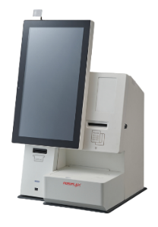
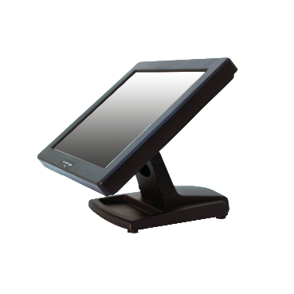
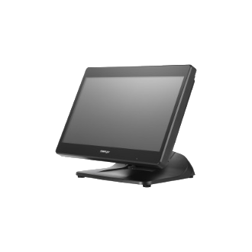
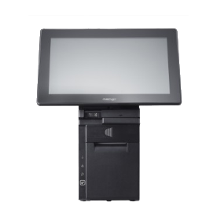
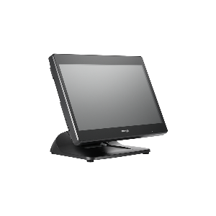
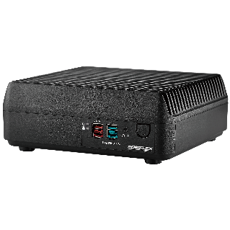
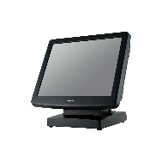

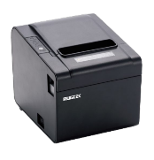
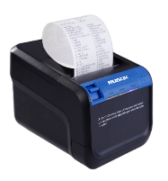











lE
P O I N T O F S A L E S ( P O S )
POS Terminals
10 Inch to 21.5 Inch POS Terminals
All in One POS
Windows & Android OS
POS Box
Fan-Free POS Box
Mobile POS
Windows & Android OS
Self Service Kiosks
15.6 to 32 Inch Systems
POS Monitors
9.7 to 17 Inch Screen Sizes
POS Printers
Value Line & Rugged Series
Cash Drawers
Value Line & Rugged Series
POS Keyboards
Multiple Programmable Keys
Barcode Scanners
Advanced Retail Barcode Scanners
Swipe Readers
Magnetic Stripe Card Readers
Side Attachments
For MSR and Scanners
i n f o @ w e b s a n k a l p . c o m | 9 3 2 6 8 2 5 8 9 5 | w w w . w e b s a n k a l p . c o m
P u n e | S a m b h a j I n a g a r | N a s h I k | M u m b a i

Slide 6















lE
I N D U S T R I A L T O U C H P A N E L S & P C’S
Embedded Box PC
Embedded Computing Technology
Expandable Slot Box PC
Rugged & Fanless
Industrial IOT Gateway
Compact & Rugged, Fanless
Edge AI Systems
Compact & Fanless Systems
Rackmount Chassis
Industrial Grade, Customer Centric
Industrial PC
Extremely Convenient SBC’s
Industrial Motherboards
Ultimate Performance & Reliability
Passive Backplane
Single Board Computers
Power Supplies
Stable & High Performance
Industrial Panel PC
Competitive & Value Optimized
Industrial Displays
Sizes From 12 to 55 Inch
Network Appliance
Custom Network Appliance
i n f o @ w e b s a n k a l p . c o m | 9 3 2 6 8 2 5 8 9 5 | w w w . w e b s a n k a l p . c o m
P u n e | S a m b h a j I n a g a r | N a s h I k | M u m b a i

Slide 7
Thank you
WebSankalp Technologies
Regd Office: E 104, Savali Homes, Uruli Devachi, Pune - 412308
Sales Office: A701, Fortuna Society, Dhayari, Pune – 411041
Questions?
Email: info@websankalp.com
Call: 9326825895
Associate Company: iAIDC Technologies Private Limited

